Slide 1
Introduction to Machine learning
FEB 2019
Prepared by - Ishan

Slide 2
1
Introduction to Machine learning
2
Machine learning applications
3
Main Categories of ML algorithms
4
Common Machine Learning Algorithms and Coding
5
Debugging

Slide 3
1
Introduction to Machine learning
2
Machine learning applications
3
Main Categories of ML algorithms
4
Common Machine Learning Algorithms and Coding
5
Debugging

Slide 4
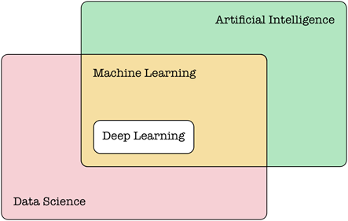
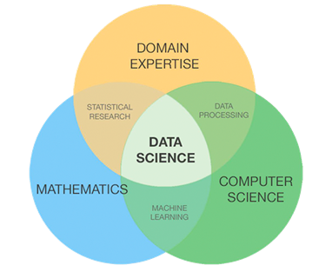
AI, ML & Data Science Definitions
Artificial Intelligence - In the field of computer science, artificial intelligence (AI), is the theory and development of computer systems able to perform intelligent and cognitive tasks normally requiring human intelligence, such as for example visual perception, speech recognition, decision-making, or translation between languages
Machine Learning - it is as a subset of artificial intelligence. It gives computers the ability to learn without being explicitly programmed. In this context, computer systems use algorithms and statistical models to effectively perform a specific task without using explicit instructions, relying on models and inference instead.
Data Science - Data science is an interdisciplinary field that uses scientific methods, processes, algorithms and systems to extract knowledge and insights from data in various forms, both structured and unstructured, similar to data mining.

Slide 5
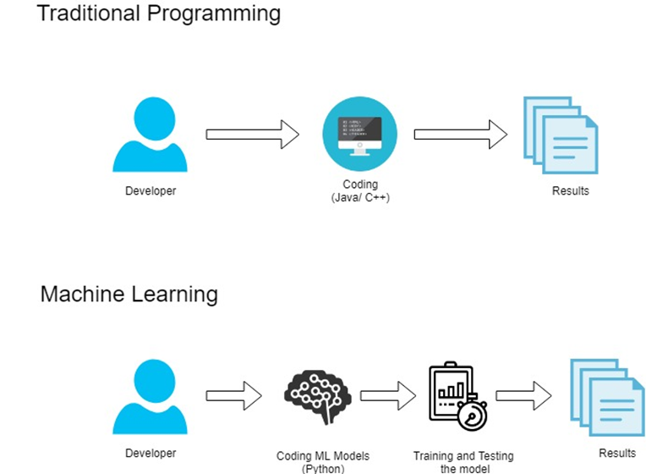
Traditional programming vs ML

Slide 6
Machine learning
Machine learning (ML) is the scientific study of algorithms and statistical models that computer systems use to effectively perform a specific task without using explicit instructions, relying on patterns and inference instead. It is seen as a subset of artificial intelligence.
Machine learning algorithms build a mathematical model of sample data, known as "training data", in order to make predictions or decisions without being explicitly programmed to perform the task.
Used on complex tasks where it’s hard to develop algorithms with handcrafted-rules
Exploits patterns in observed data and extract rules automatically

Slide 7
1
Introduction to Machine learning
2
Machine learning applications
3
Main Categories of ML algorithms
4
Common Machine Learning Algorithms and Coding
5
Debugging

Slide 8
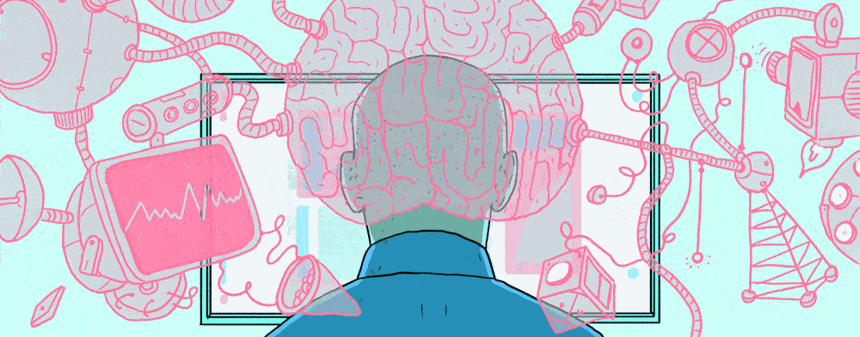

Fields of application
Computer vision
Speech recognition
Financial analysis
Search engines
Ads-targeting
Content suggestion
Self-driving cars
Assistants
etc...

Slide 9
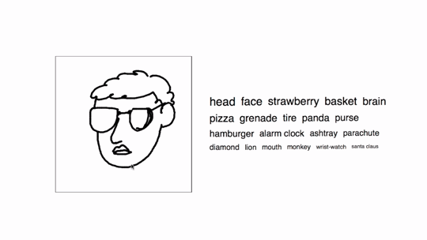
Computer Vision

Slide 10
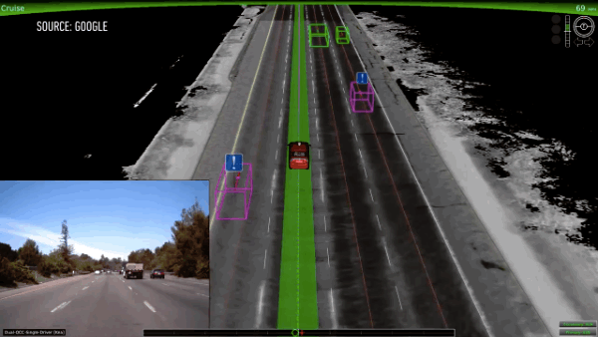
Self Driving Car

Slide 11

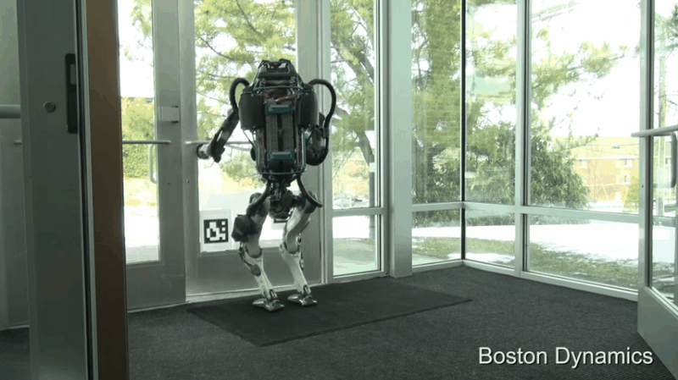
Reinforcement Learning

Slide 12

Deep Fakes

Slide 13
Machine Learning Pipeline
INGESTION
PREPARATION
MODEL TRAINING
MODEL DEPLOYMENT
PREDICTIONS
Bias Analysis
At Client
Normalization
On Backend
Data Lake
ETL Operations
Incremental Retraining
RETRAINING

Slide 14
Ingestion
Data ingestion is the process of obtaining and importing data. Data can be streamed in real time or ingested in batches.
Extract, Transform, Load (ETL) is the general procedure of copying data from one or more sources into a destination system which represents the data differently from the source(s).
A data lake is a system or repository of data stored in its natural format, usually object blobs or files.
INGESTION
PREPARATION
MODEL TRAINING
MODEL DEPLOYMENT
PREDICTIONS
Bias Analysis
At Client
Normalization
On Backend
Data Lake
ETL Operations
Incremental Retraining
RETRAINING

Slide 15
Preparation
Data preparation is the act of preparing (or pre-processing) raw data or disparate data sources into refined information assets that can be used effectively for various business purposes, such as analysis.
When you normalize data you eliminate the units of measurement for data, enabling you to easily compare data from different places.
Using deep analysis of data to help you with decision making is a good idea but it can also backfire if the data is biased.
INGESTION
PREPARATION
MODEL TRAINING
MODEL DEPLOYMENT
PREDICTIONS
Bias Analysis
At Client
Normalization
On Backend
Data Lake
ETL Operations
Incremental Retraining
RETRAINING

Slide 16
Model Training
The process of training an ML model involves providing an ML algorithm (that is, the learning algorithm) with training data to learn from. The term ML model refers to the model artifact that is created by the training process.
You can use the ML model to get predictions on new data for which you do not know the target.
INGESTION
PREPARATION
MODEL TRAINING
MODEL DEPLOYMENT
PREDICTIONS
Bias Analysis
At Client
Normalization
On Backend
Data Lake
ETL Operations
Incremental Retraining
RETRAINING

Slide 17
Model Deployment
The concept of deployment in data science refers to the application of a model for prediction using new data. Building a model is generally not the end of the project.
Depending on the requirements, the deployment phase can be as simple as generating a report or as complex as implementing a repeatable data science process.
INGESTION
PREPARATION
MODEL TRAINING
MODEL DEPLOYMENT
PREDICTIONS
Bias Analysis
At Client
Normalization
On Backend
Data Lake
ETL Operations
Incremental Retraining
RETRAINING

Slide 18
Predictions
Prediction refers to the output of an algorithm after it has been trained on a historical dataset and applied to new data when you're trying to forecast the likelihood of a particular outcome.
INGESTION
PREPARATION
MODEL TRAINING
MODEL DEPLOYMENT
PREDICTIONS
Bias Analysis
At Client
Normalization
On Backend
Data Lake
ETL Operations
Incremental Retraining
RETRAINING

Slide 19
Retraining
Used to maintain machine learning systems.
Ensures that the predictions continue to be accurate, with the help of new training data.
Some of the ways to ensure this : manual retraining, continuous learning.
INGESTION
PREPARATION
MODEL TRAINING
MODEL DEPLOYMENT
PREDICTIONS
Bias Analysis
At Client
Normalization
On Backend
Data Lake
ETL Operations
Incremental Retraining
RETRAINING

Slide 20
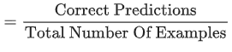
Common terminologies in ML
Accuracy
Bag of words: A representation of the words in a phrase or passage, irrespective of order. For example, bag of words represents the following three phrases identically:
the dog jumps
jumps the dog
dog jumps the
Cross-validation: A mechanism for estimating how well a model will generalize to new data by testing the model against one or more non-overlapping data subsets withheld from the training set.
DataFrame: A popular datatype for representing datasets in pandas. A DataFrame is analogous to a table. Each column of the DataFrame has a name (a header), and each row is identified by a number.
Feature: An input variable used in making predictions.
Feature set: The group of features your machine learning model trains on. For example, postal code, property size, and property condition might comprise a simple feature set for a model that predicts housing prices.

Slide 21
1
Introduction to Machine learning
2
Machine learning applications
3
Main Categories of ML algorithms
4
Common Machine Learning Algorithms and Coding
5
Debugging

Slide 22
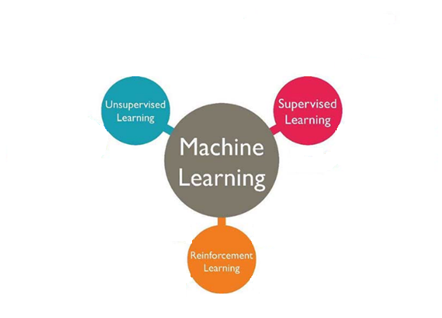
Main categories of ML algorithms

Slide 23
Supervised Algorithms
“The outcome or output for the given input is known before itself”
and the machine must be able to map or assign the given input to the output.
Examples : Regression, Classification

Slide 24
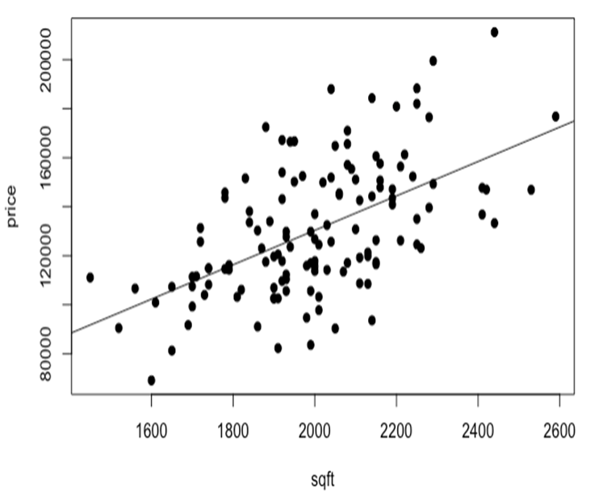
Regression vs Classification
Regression Predict house price based on the area of house.
Learn a function mapping an input element to a real value. i.e: Predict the temperature of tomorrow given some meteo signals

Slide 25
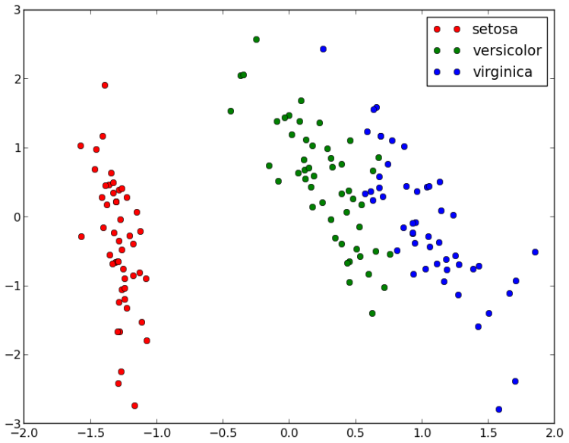
Regression vs Classification
Classification Predict flower category based on its dimensions.
Learn a function mapping an input element to a class (within a finite set of possible classes).
i.e: Predict the weather of tomorrow: {sunny, cloudy, rainy} given some meteo signals

Slide 26
Unsupervised Algorithms
“The outcome or output for the given inputs is unknown”,
here input data is given and the model is run on it.

Slide 27
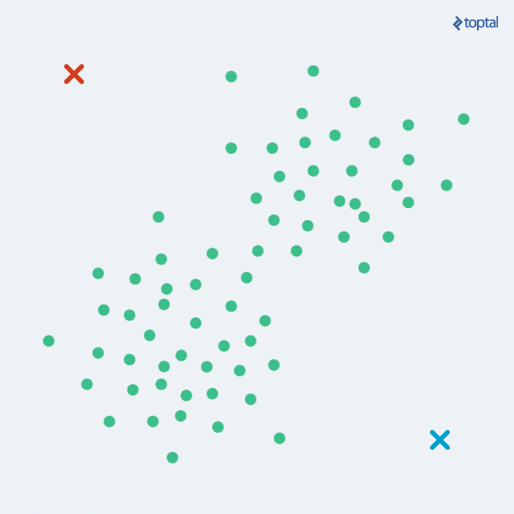
Clustering
A clustering algorithm separate different observed data points in similar groups (clusters). We do not know the labels during training.

Slide 28
Reinforcement Learning
The machine is exposed to an environment where it gets trained by trial and error method.
The machine learns from past experience and tries to capture the best possible knowledge to make accurate decisions based on the feedback received.

Slide 29
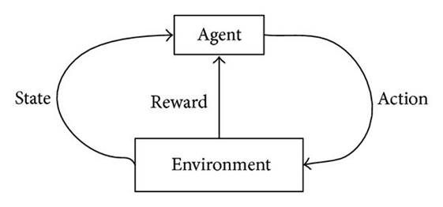
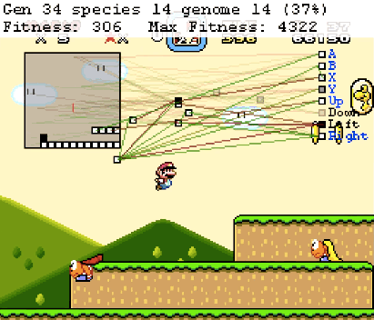
Reinforcement learning
Learn the optimal behavior for an agent in an environment to maximize a given goal.
Examples:
Drive a car on a road and minimize the collision risk
Play Super Mario
Choose the position of ads on a website to maximize the number of clicks

Slide 30
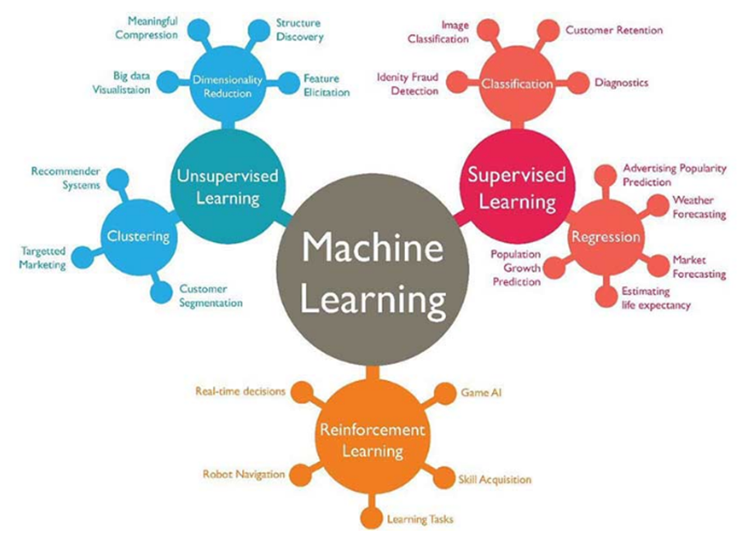
Examples of ML Algorithm applications

Slide 31
1
Introduction to Machine learning
2
Machine learning applications
3
Main Categories of ML algorithms
4
Common Machine Learning Algorithms and Coding
5
Debugging

Slide 32
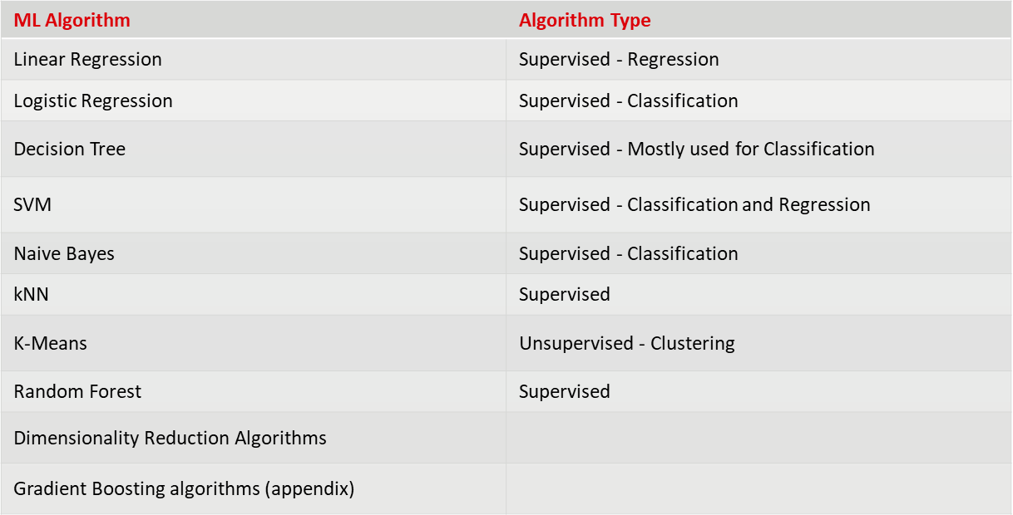
List of Common Machine Learning Algorithms

Slide 33
Some more common terminologies in ML
Generalization: Refers to your model's ability to make correct predictions on new, previously unseen data as opposed to the data used to train the model.
Hyperparameter: The "knobs" that you tweak during successive runs of training a model. For example, learning rate is a hyperparameter.
Inference: In machine learning, often refers to the process of making predictions by applying the trained model to unlabeled examples. In statistics, inference refers to the process of fitting the parameters of a distribution conditioned on some observed data.
Label: In supervised learning, the "answer" or "result" portion of an example. Each example in a labeled dataset consists of one or more features and a label. For instance, in a housing dataset, the features might include the number of bedrooms, the number of bathrooms, and the age of the house, while the label might be the house's price.
Loss: A measure of how far a model's predictions are from its label.
One-hot encoding: A sparse vector in which, One element is set to 1 and all other elements are set to 0.
Overfitting: Creating a model that matches the training data so closely that the model fails to make correct predictions on new data.
Underfitting: Producing a model with poor predictive ability because the model hasn't captured the complexity of the training data.

Slide 34

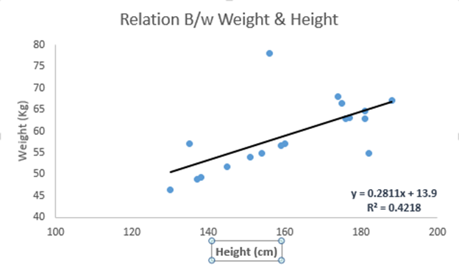
Linear Regression
It is used to estimate real values (cost of houses, number of calls, total sales etc.) based on continuous variable(s).
Two types:
Simple Linear Regression
Multiple Linear Regression
Coding Time !
C:\Users\... > jupyter notebook

Slide 35

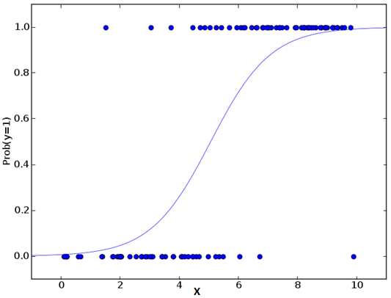
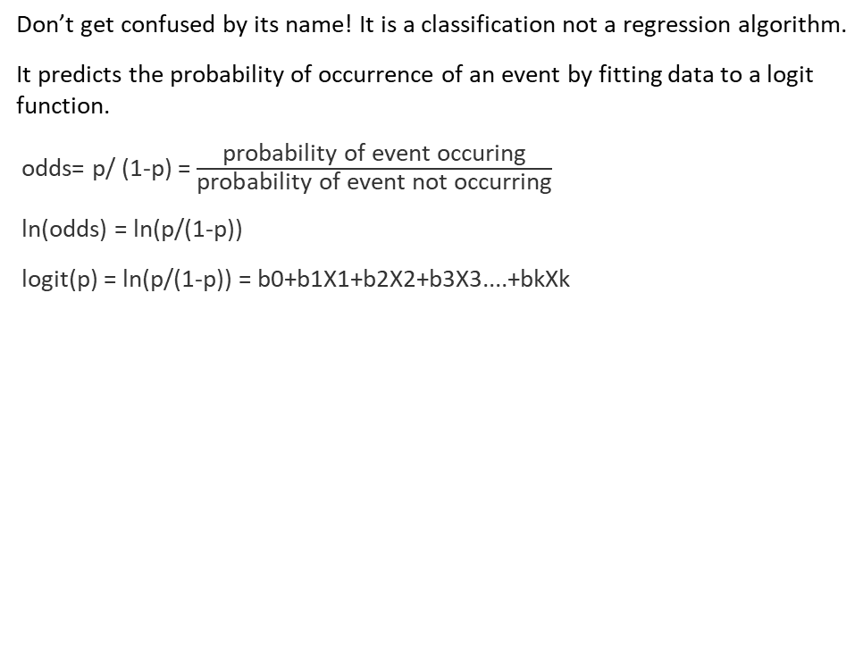
Logistic Regression
Don’t get confused by its name! It is a classification not a regression algorithm.
It predicts the probability of occurrence of an event by fitting data to a logit function.
odds= p/ (1-p) = $\frac{\text{probability} \text{of} \text{event} \text{occuring}}{\text{probability} \text{of} \text{event} \text{not} \text{occurring}}$
ln(odds) = ln(p/(1-p))
logit(p) = ln(p/(1-p)) = b0+b1X1+b2X2+b3X3....+bkXk
Coding Time !
C:\Users\... > jupyter notebook

Slide 36

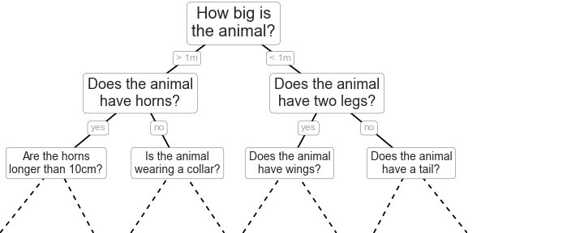
Decision Tree
It is a type of supervised learning algorithm that is mostly used for classification problems.
Coding Time !
C:\Users\... > jupyter notebook

Slide 37
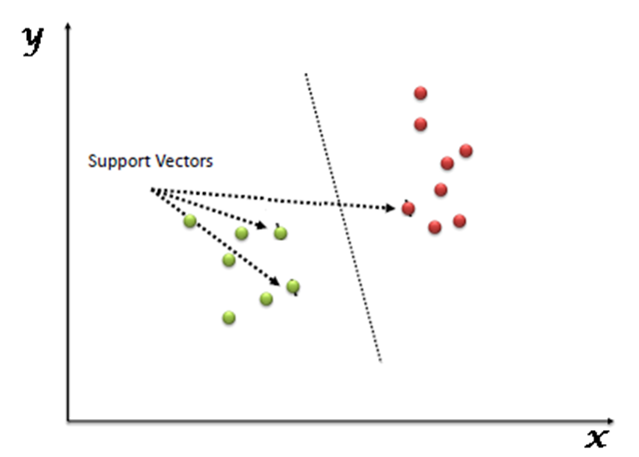
SVM
“Support Vector Machine” (SVM) is a supervised machine learning algorithm which can be used for both classification or regression challenges.
In this algorithm, we plot each data item as a point in n-dimensional space (where n is number of features you have) with the value of each feature being the value of a particular coordinate. Then, we perform classification by finding the hyper-plane that differentiate the two classes very well.
Support Vectors are simply the co-ordinates of individual observation. Support Vector Machine is a frontier which best segregates the two classes (hyper-plane/ line).

Slide 38
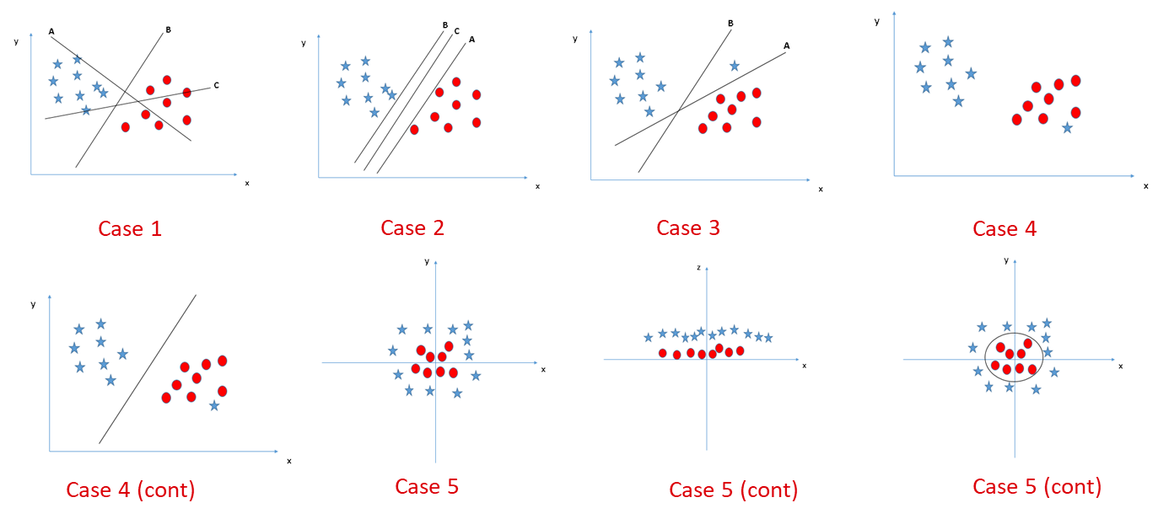
SVM: Identifying the hyper-plane

Slide 39

Coding Time !
C:\Users\... > jupyter notebook

Slide 40

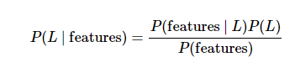
Linear Naive Bayes
Naive Bayes models are a group of extremely fast and simple classification algorithms that are often suitable for very high-dimensional datasets.
In Bayesian classification, we're interested in finding the probability of a label given some observed features, which we can write as P(L | features). Bayes's theorem tells us how to express this in terms of quantities we can compute more directly:
Coding Time !
C:\Users\... > jupyter notebook

Slide 41
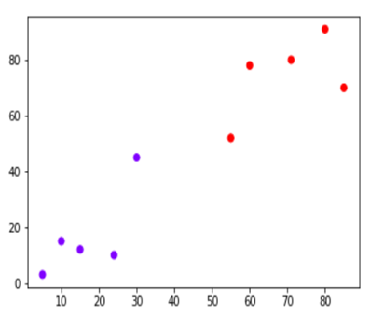
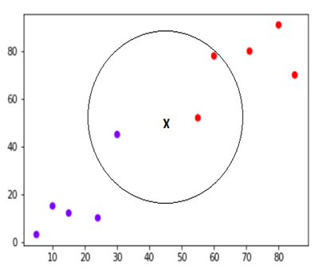
kNN (k- Nearest Neighbors)
The K-nearest neighbors (KNN) algorithm is a type of supervised machine learning algorithms.
KNN is extremely easy to implement in its most basic form, and yet performs quite complex classification tasks. It is a lazy learning algorithm since it doesn't have a specialized training phase. Rather, it uses all of the data for training while classifying a new data point or instance.
KNN is a non-parametric learning algorithm, which means that it doesn't assume anything about the underlying data. This is an extremely useful feature since most of the real world data doesn't really follow any theoretical assumption e.g. linear-separability, uniform distribution, etc.

Slide 42

Coding Time !
C:\Users\... > jupyter notebook

Slide 43
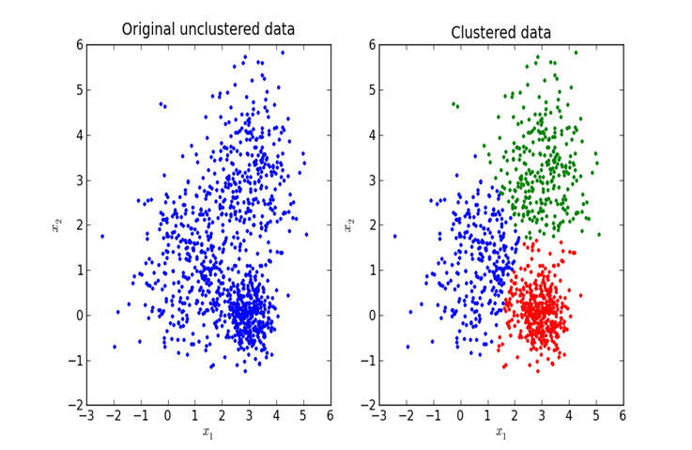
K-Means
Clustering is a type of Unsupervised learning.
This is very often used when you don’t have labeled data.
K-Means Clustering is one of the popular clustering algorithm.
The goal of this algorithm is to find groups(clusters) in the given data.

Slide 44
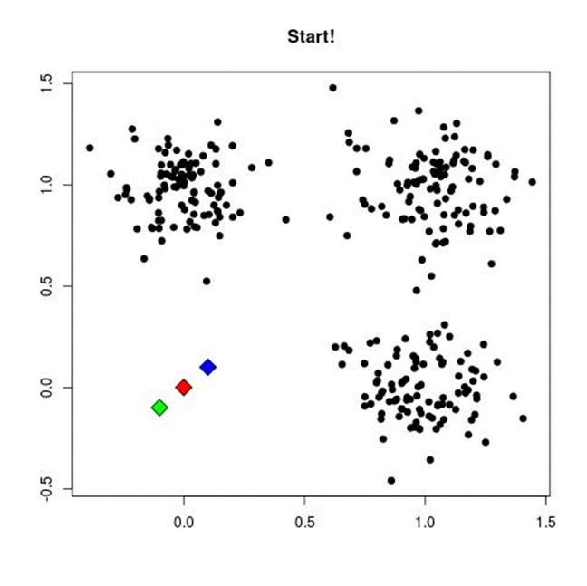
K-Means (cont.)
Algorithm:
Pick K random points as cluster centers called centroids.
Assign each 𝑥_𝑖 to nearest cluster by calculating its distance to each centroid.
Find new cluster center by taking the average of the assigned points.
Repeat Step 2 and 3 until none of the cluster assignments change.

Slide 45

Coding Time !
C:\Users\... > jupyter notebook

Slide 46
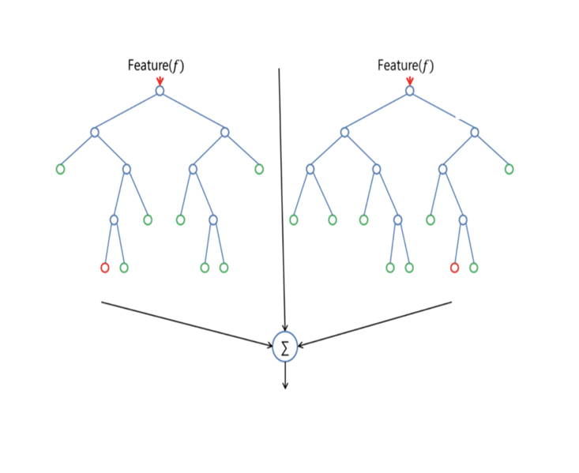
Random Forest
Random Forest is a supervised learning algorithm. Like you can already see from it’s name, it creates a forest and makes it somehow random. The forest it builds, is an ensemble of Decision Trees, most of the time trained with the “bagging” method. The general idea of the bagging method is that a combination of learning models increases the overall result.
To say it in simple words: Random forest builds multiple decision trees and merges them together to get a more accurate and stable prediction.

Slide 47

Coding Time !
C:\Users\... > jupyter notebook

Slide 48
Dimensionality Reduction Algorithms (Theory)
In machine learning classification problems, there are often too many factors on the basis of which the final classification is done. These factors are basically variables called features.
The higher the number of features, the harder it gets to visualize the training set and then work on it.
Sometimes, most of these features are correlated, and hence redundant. This is where dimensionality reduction algorithms come into play.
Dimensionality reduction is the process of reducing the number of random variables under consideration, by obtaining a set of principal variables. It can be divided into feature selection and feature extraction.

Slide 49
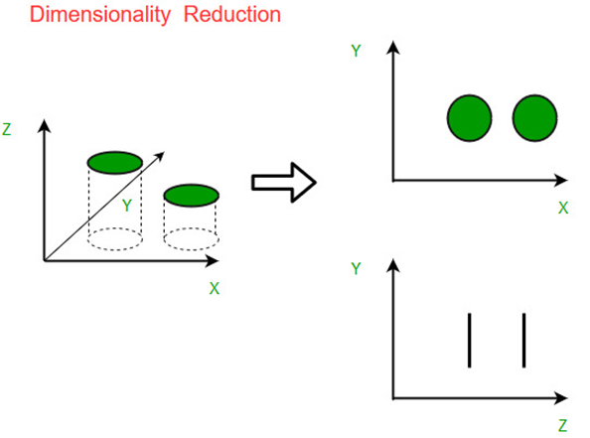
Dimensionality Reduction Algorithms (cont.)
Why is Dimensionality Reduction important in Machine Learning and Predictive Modeling?
The various methods used for dimensionality reduction include:
Principal Component Analysis (PCA)
Linear Discriminant Analysis (LDA)
Generalized Discriminant Analysis (GDA)

Slide 50
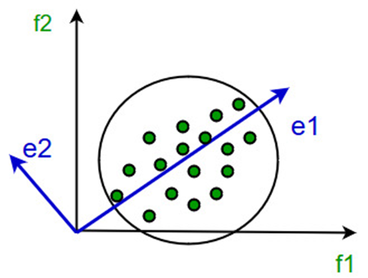
Dimensionality Reduction Algorithms (cont.)
Principal Component Analysis
It works on a condition that while the data in a higher dimensional space is mapped to data in a lower dimension space, the variance of the data in the lower dimensional space should be maximum.
It involves the following steps:
Construct the covariance matrix of the data.
Compute the eigenvectors of this matrix.
Eigenvectors corresponding to the largest eigenvalues are used to reconstruct a large fraction of variance of the original data.

Slide 51
1
Introduction to Machine learning
2
Machine learning applications
3
Main Categories of ML algorithms
4
Common Machine Learning Algorithms and Coding
5
Debugging

Slide 52

Debugging in ML
When building machine learning models, you’ll often run into situations where a model is not working as well as you would like. Maybe the error rate is too high or the model works fine on the training data, but fails when you apply real world data.

Slide 53

Debugging (cont.) - Typical problems
A machine learning algorithm will generally suffer from one of two problems – high bias or high variance.
High bias is when your algorithm is bad at fitting the data and miss relevant relations between the input features and the predicted output. High bias is also called underfitted – meaning your model is not fitting the data very well and makes poor predictions.
High variance on the other hand is when your algorithm is bad at generalizing. This is normally the case if your algorithm fit the training data perfectly, but when applied to previously unseen data it fails to make good predictions. High variance is also called overfitting.
The image shows examples of a model with high bias (black line) and with high variance (blue line).

